Slide 1
Data Analysis of SDG Indicators
Ben, Janice, Lan Ran, Shawn Kit, Stefan

Slide 2
GOALS
01
04
EXAMINING CORRELATION
INITIAL HYPOTHESIS
02
UN SUSTAINABLE DEVELOPMENT
05
CONCLUSION &
LURKING VARIABLES
03
SUMMARY OF INDICATORS
06
PERMUTATIONS
07
NEW INDICATORS
Notes:
This is the content of our presentation, following the order of the various tasks

Slide 3
UHC INDEX
Universal health coverage (UHC) service coverage index
DEVELOPMENT ASSISTANCE
Total official development assistance (gross disbursement) for water supply and sanitation, by recipient countries (millions of constant 2017 United States dollars)
SATURN
Saturn is a gas giant, composed of hydrogen and helium
01
GOALS
Goal 3
Goal 6
Good Health and Well-Being
Clean Water and Sanitation
MORTALITY RATE (UNSAFE WATER)
Mortality rate attributed to unsafe water, unsafe sanitation and lack of hygiene (deaths per 100,000 population)
PROPORTION OF CLEAN WATER
Proportion of population using safely managed drinking water services(percent)
Notes:
JAN:
UHC INDEX: Coverage index for essential health services (based on tracer interventions that include reproductive, maternal, newborn and child health, infectious diseases, noncommunicable diseases and service capacity and access). It is presented on a scale of 0 to 100. Values greater than or equal to 80 are presented as 80 as the index does not provide fine resolution at high values.
Mortality Rate (Unsafe Water): Obtained data from World Health Organisation and Global Health Observatory, which summarised the data at a country level, hence we have unspecific reasons for death except that they are related to unsafe water.
SK:
Development Assistance: Based on OECD (Organisation of Economic and Cooperation Development)

Slide 4
02 Our Initial Hypothesis
 |  | GOAL 3
GOAL 6 |  | UHC SERVICE INDEX | MORTALITY RATE (UNSAFE WATER)
 | DEVELOPMENT ASSISTANCE FOR WATER SUPPLY | WEAK POSITIVE CORRELATION More $ = Better health coverage; assuming development assistance is funneled to it. (But recipient countries are poor in the first place) | STRONG NEGATIVE CORRELATION More $ = Reduced no. of deaths due to drinking untreated water. Poorer countries may have access to cleaner, unpolluted bodies of water
 | PROPORTION OF CLEAN WATER | STRONG POSITIVE CORRELATION Better access to cleaner water = Better ranking on the health coverage service index | STRONG NEGATIVE CORRELATION (Better access to cleaner water = fewer deaths due to water-borne diseases
Notes:
Top left: Weak positive correlation, because more development assistance means better infrastructure that leads to better health services. But weak because poor countries which receives the most development assistance probably rank lower on the UHC index in the first place
Bottom left: Strong positive correlation, because we believed that better health services would correspond with cleaner water
Top right: Strong negative correlation, because more development assistance leads to reduced number of deaths due to water-related diseases.However, have to note that poorer countries may have a lower mortality in the first place due to a lack of industrial-related pollution.
Bottom right: Strong negative correlation, because cleaner water means fewer deaths.

Slide 5
Summary
of Indicators
03

Slide 6
UHC Index

Slide 7
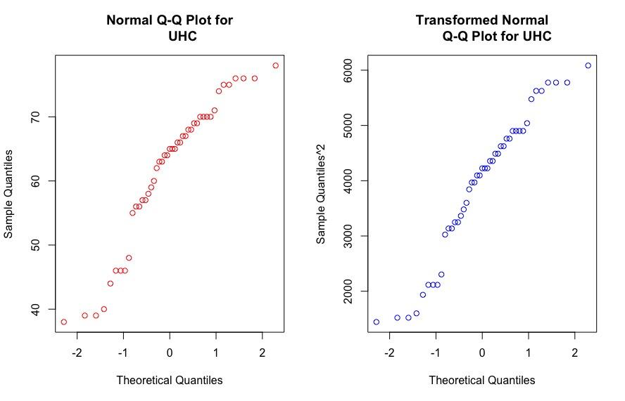
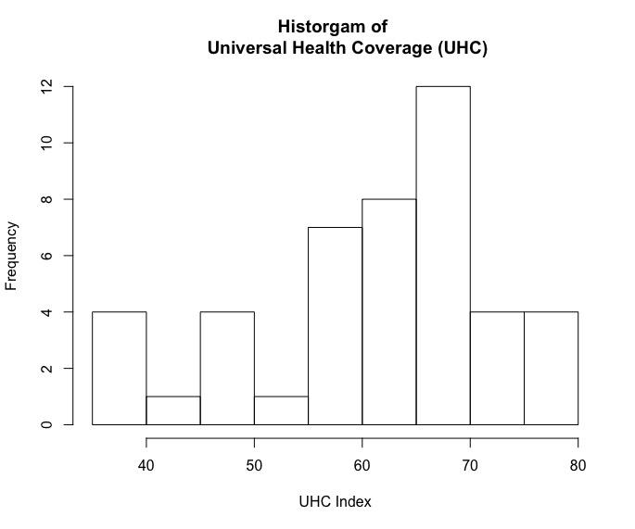
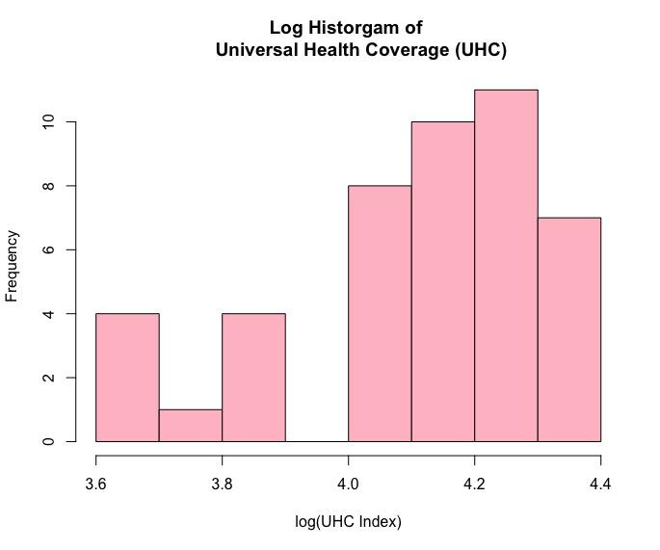
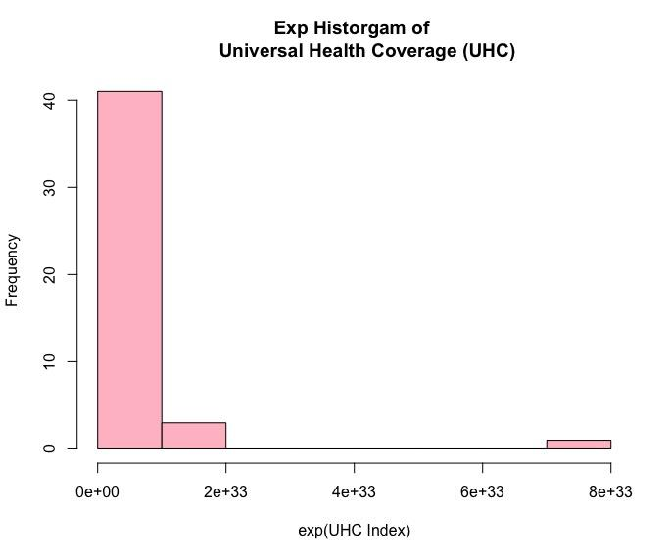
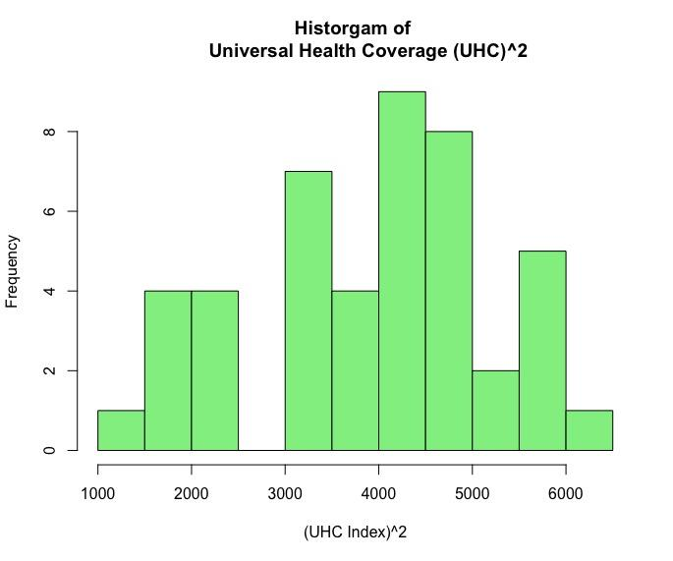
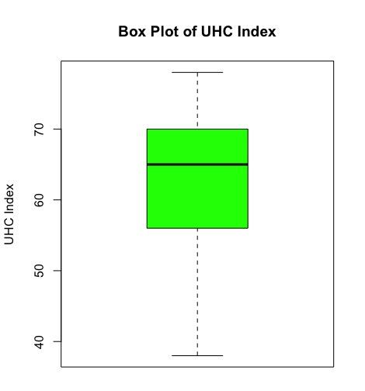
1. UHC Index
SUMMARY
Min. 38.00
1st Qu. 56.00
Median 65.00
Mean 61.74
3rd Qu. 70.00
Max. 78.00
Notes:
Min: congo
Max: peru

Slide 8
2. Mortality Rate
(Unsafe Water)

Slide 9
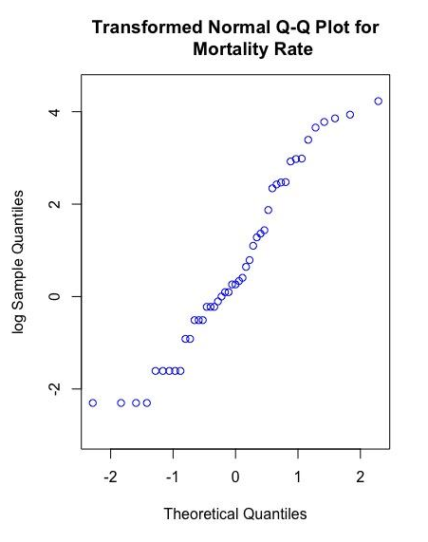
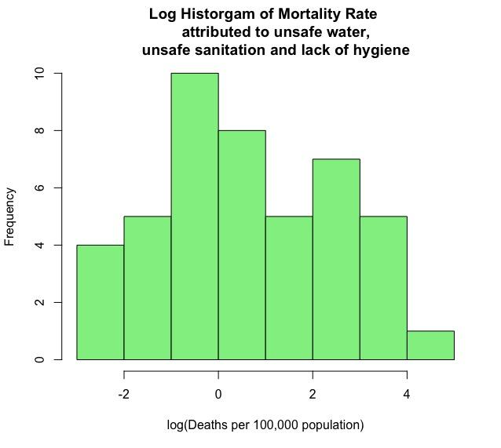
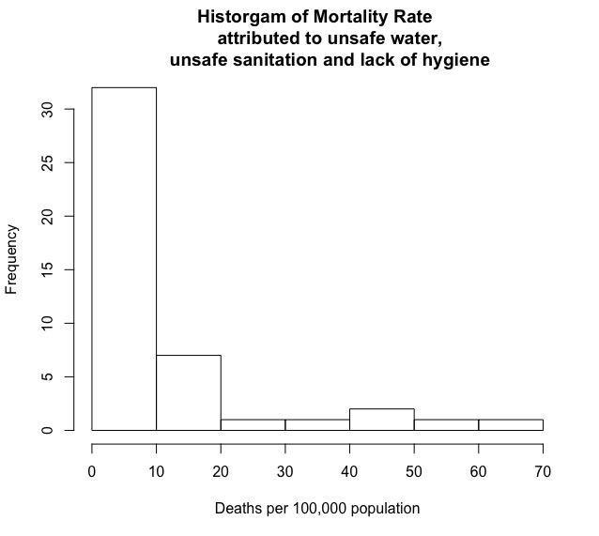
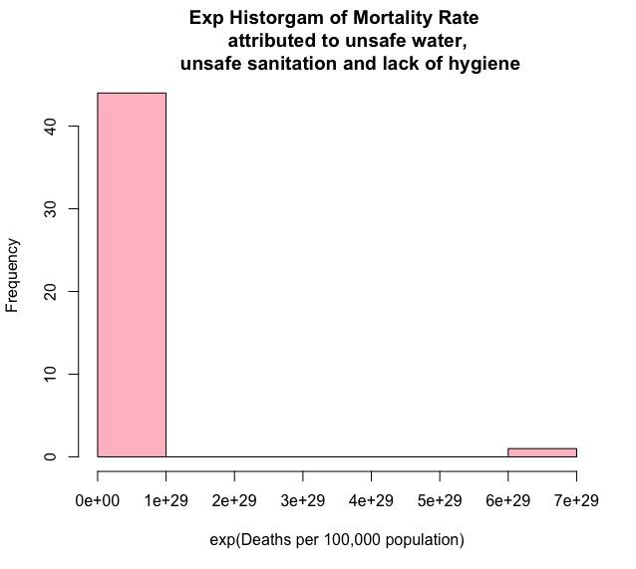
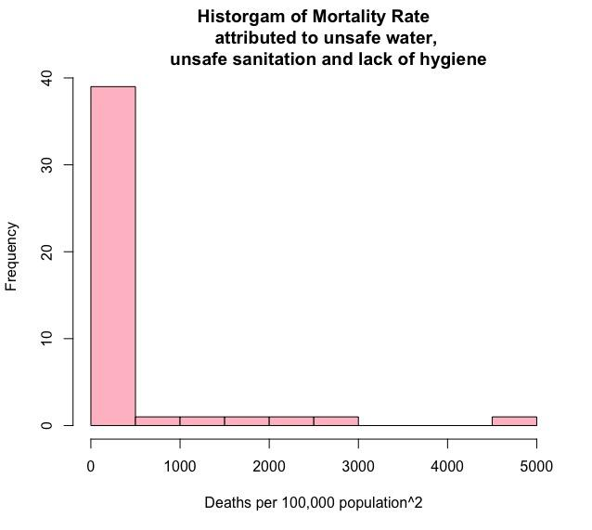
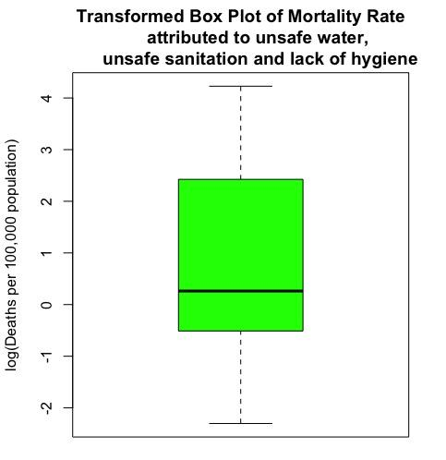
2. Mortality Rate
(Unsafe Water)
SUMMARY
Min. 0
1st Qu. 0.400
Median 1.300
Mean 9.017
3rd Qu. 10.850
Max. 68.600
Notes:
Min: montenegro (in the mountains, 5000 ppl) and oman (rich! Access to oil, in the desert ? :-O)
Max: nigeria and kenya

Slide 10
3. Development
Assistance

Slide 11
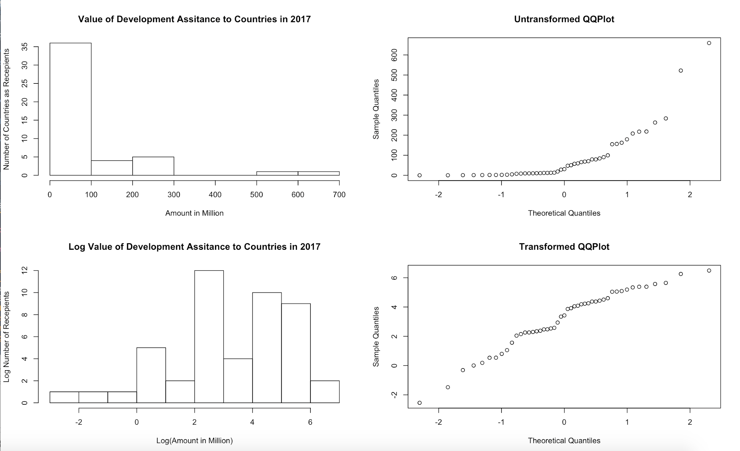
3. Development Assistance
SUMMARY
Min. 0.0785
1st Qu. 9.0686
Median 30.7620
Mean 86.9766
3rd Qu. 94.9891
Max. 659.4296

Slide 12
4. Proportion of
Clean Water

Slide 13
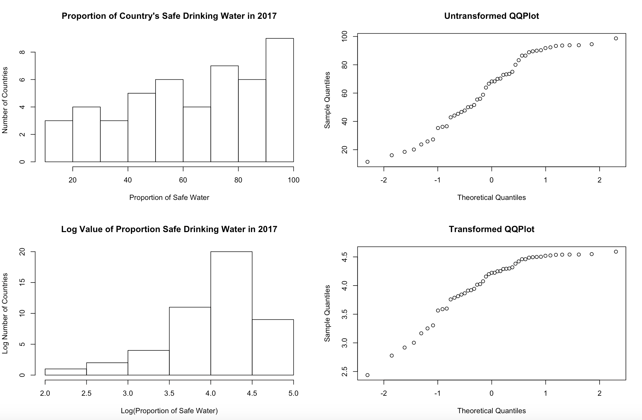
4. Proportion of Clean Water
SUMMARY
Min. 11.44
1st Qu. 44.74
Median 68.22
Mean 62.74
3rd Qu. 87.66
Max. 98.64

Slide 14
Examining Correlation
04

Slide 15
Three Main Checks:
Scatter plot
Residual plot
Histogram of residuals (and qq-plot)

Slide 16
Scatter Plot Check:
Not outliers
Quantitative variables
Straight enough
Does the plot thicken?

Slide 17
Residual Plot Check:
No interesting feature
No direction / shape / bends (systematic error)
No outliers (big random error)

Slide 18
Histogram / QQ-Plot Check:
Residuals should be normally distributed
If not, amount of error is not consistent across the full range of the observed data
Linear model not a good fit!

Slide 19
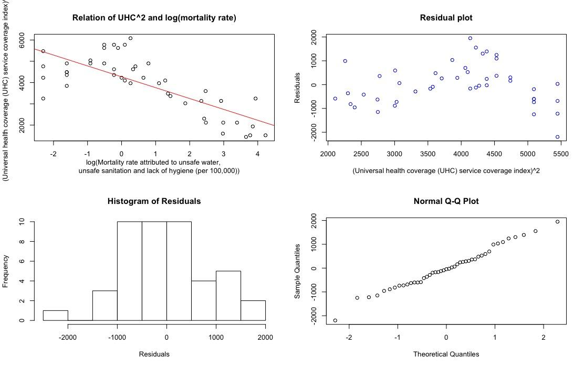
Plot 1:
Relation for Goal 3
(Good Health)
#R = -0.76001
#R^2 = 0.57762
Notes:
Linear model check:
No outliers →
Quantitative variables →
Straight enough →
Does the plot thicken? →
Is the correlation strong enough to make linear model?
R = -0.76 →
Residuals: Residuals tells us the difference between the observed and predicted
What’s leftover that the model does not explain
Observed - Prediction = Residual
Positive Value = Underestimation
Negative Value = Overestimation
Good regression model
If the residual scatterplot has no interesting features:
No direction
No shape
No bends
No outliers
No obvious shape

Slide 20
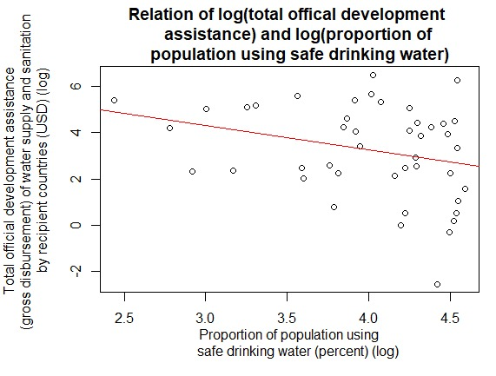
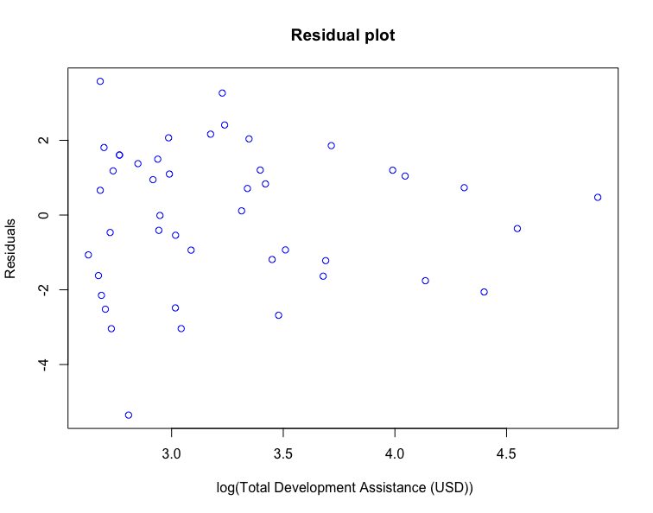
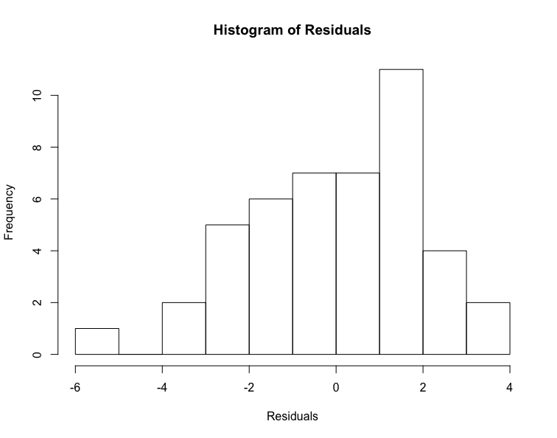
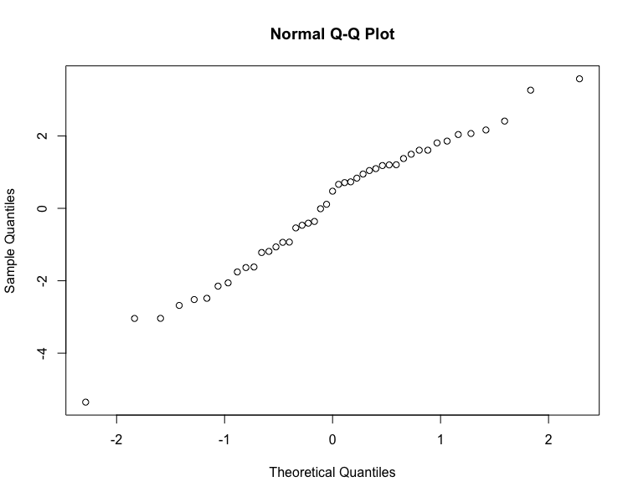
Plot 2:
Relation for Goal 6
(Clean Water)
#R = -0.28749
#R^2= 0.082649

Slide 21
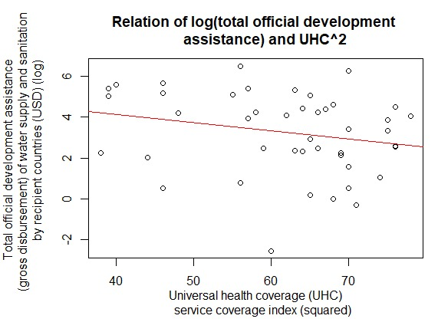
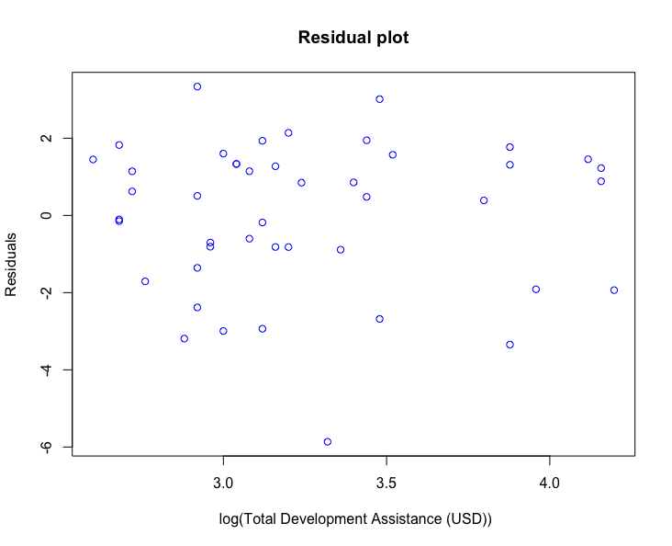
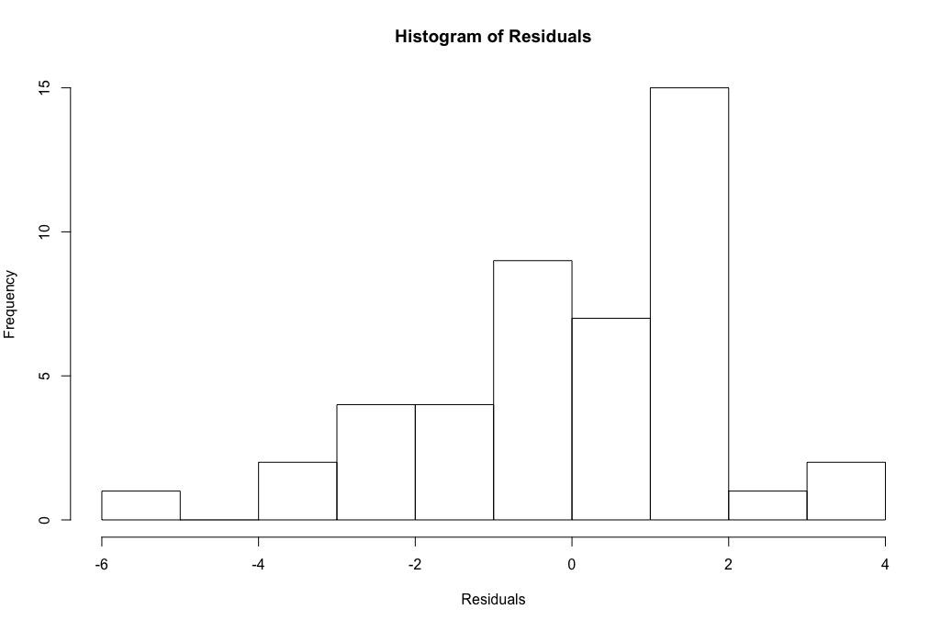
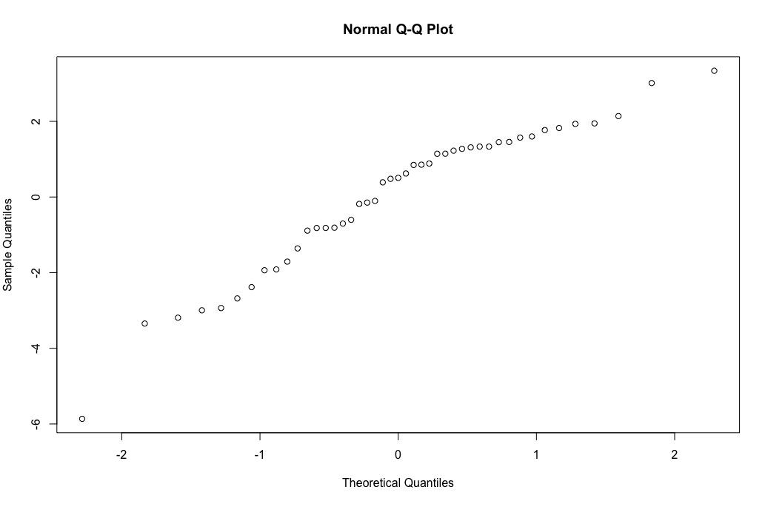
Plot 3:
UHC Index x Development Assistance
#R = -0.21922
#R^2 = 0.048058

Slide 22
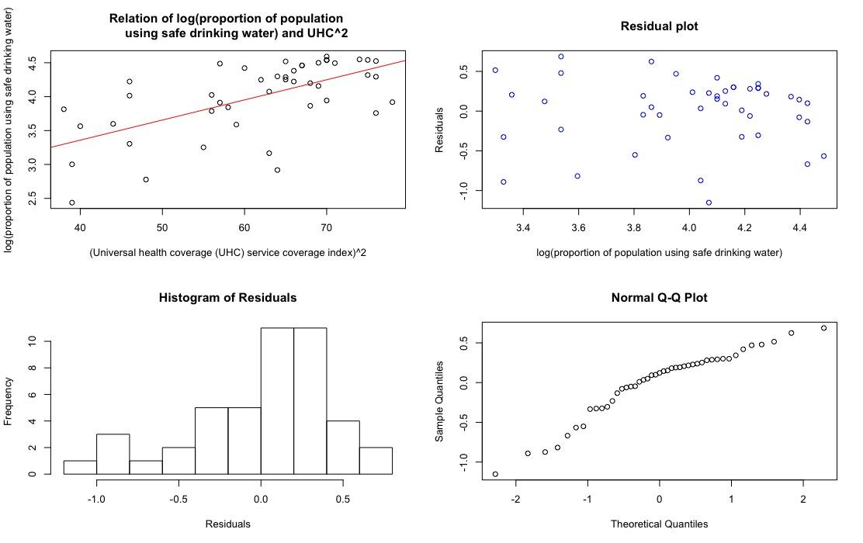
#R = 0.60612
#R^2= 0.36739
Plot 4:
UHC Index x
Proportion of Clean Water

Slide 23
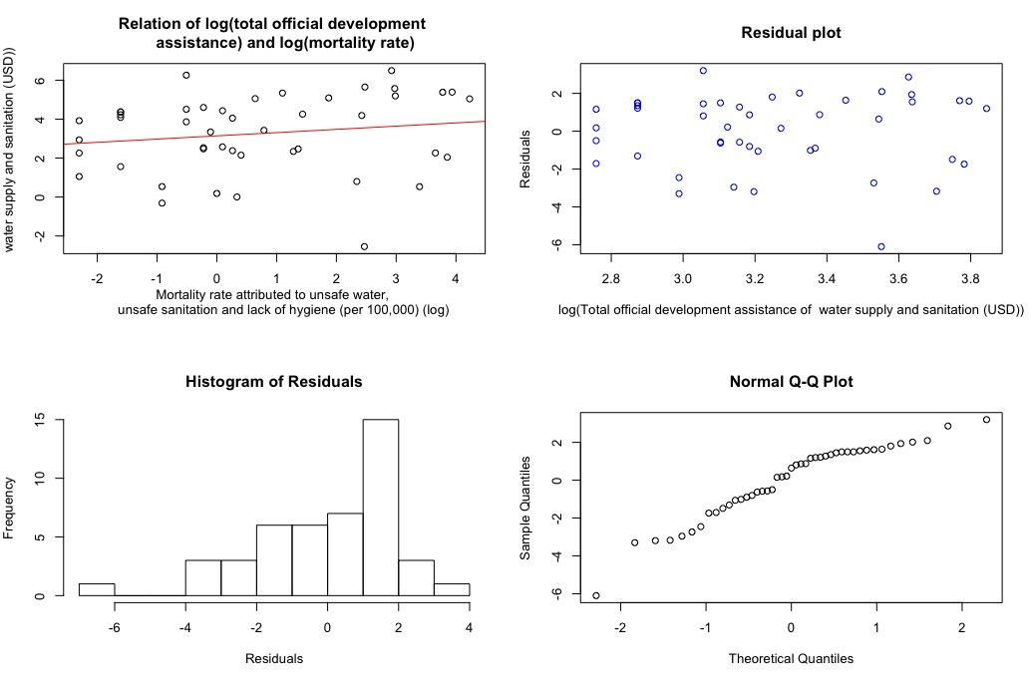
Plot 5:
Mortality Rate
(Unsafe Water) x Development Assistance
#R = 0.16270
#R^2 = 0.026470

Slide 24
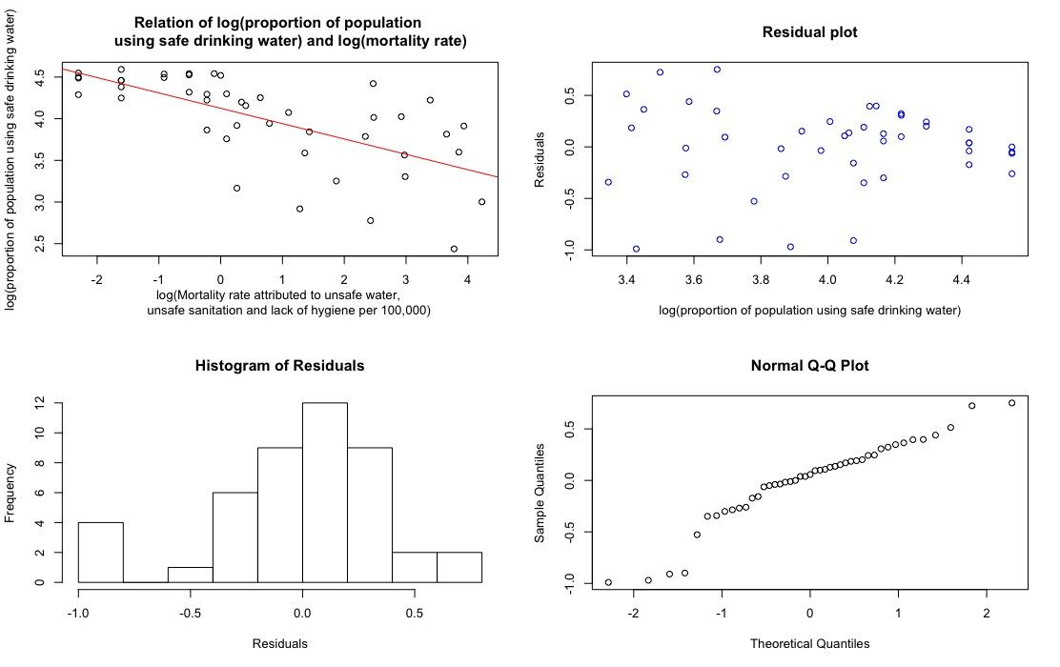
Plot 6:
Mortality Rate
(Unsafe Water) x
Proportion Clean Water
#R = -0.66490
#R^2= 0.44210

Slide 25
Conclusion &
Lurking Variables
05
Notes:
Uhc mort: #Y = -511.1617X + 4269.4353
Prop safe uhc: #Y = 0.029660X + 2.1721
Prop safe mort: #Y = -0.18446X + 4.1246
Total dev mort: #Y = 0.16631X + 3.1410
Total dev uhc: #Y = -0.039909X + 5.7137
Total dev prop safe: #Y = -1.0593X + 7.4906

Slide 26
Plot 1: Relation for Goal 3 (UHC x Mortality rate from unsafe water)
Initial Hypothesis
Conclusion
Lurking Variables
Strong negative correlation
→ we are right!
UHC^2 = -511.1617(log(mortality)) + 4269.4353
R = -0.76001
Economic power of the country

Slide 27
Plot 2: Relation for Goal 6 (development assistance x proportion safe water)
Initial Hypothesis
Conclusion
Lurking Variables
Strong Positive Correlation
→ we are wrong :(
→ Weak negative correlation
log(total_dev) = -1.0593X + 7.4906
R = -0.28749
Economic power of the country

Slide 28
Plot 3: UHC Index x Development Assistance
Initial Hypothesis
Conclusion
Lurking Variables
Strong positive correlation
→ we are wrong :(
→ Weak negative correlation
log(total dev) = -0.039909(UHC^2) + 5.7137
R = -0.21922
Different focus of each government
(e.g. focus on water but neglect health care)

Slide 29
Plot 4: UHC Index x
Proportion of Clean Water
Initial Hypothesis
Conclusion
Lurking Variables
Strong positive correlation
→ we are wrong :(
→ Strong negative correlation
log(prop safe) = 0.029660(UHC^2) + 2.1721
R = 0.60612
Ratio of people living in urban/rural

Slide 30
Plot 5: Mortality Rate (Unsafe Water) x Development Assistance
Initial Hypothesis
Conclusion
Lurking Variables
Strong negative correlation
→ we are almost right!
→ Weak negative correlation
log(total dev) = 0.16631(log(mortality)) + 3.1410
R = 0.16270
Change due to assistance may not have occurred yet

Slide 31
Plot 6: Mortality Rate (Unsafe Water) x Proportion Clean Water
Initial Hypothesis
Conclusion
Lurking Variables
Strong negative correlation
→ we are correct!
UHC^2 = -0.18446(log(total dev)) + 4.1246
R = -0.66490
Amount of money being channeled into providing safe drinking water

Slide 32
Permutations
06

Slide 33
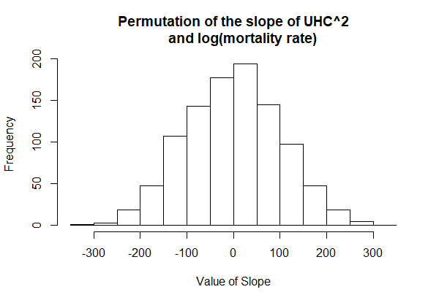
Initial Slope: -511
Mean: -0.51892
Minimum: -330.72
Statistically Significant!
Histogram 1:
UHC and Mortality Rate
Notes:
Work Method: We have chosen to simulate 1000 trials of permuting the first variable (UHC^2) in order to see if our specific slope value is due to randomness alone. In terms of R code, we have used “for-loops” and “sample” function to shuffle the values of the first variable.
Because our initial slope( with no permutation) was way lower than the minimum of the randomized trial values, we came to the conclusion that the slope of our model is statistically significant.

Slide 34
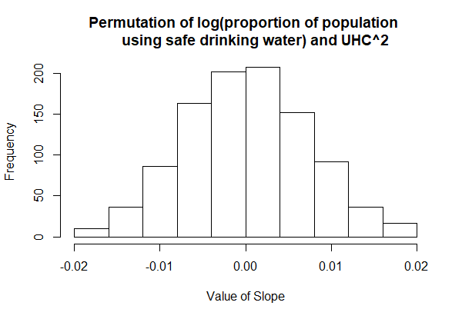
Initial Slope: 0.029660
Mean: -0.00013328
Maximum: 0.019823
Statistically
Significant!
Histogram 2:
Proportion of Safe Water and UHC
Notes:
Work Method: We have chosen to simulate 1000 trials of permuting the first variable (log(proportion of population using safe drinking water)) in order to see if our specific slope value is due to randomness alone. In terms of R code, we have used “for-loops” and “sample” function to shuffle the values of the first variable.
Because our initial slope( with no permutation) was bigger than the maximum of the randomized trial values, we came to the conclusion that the slope of our model is statistically significant.

Slide 35
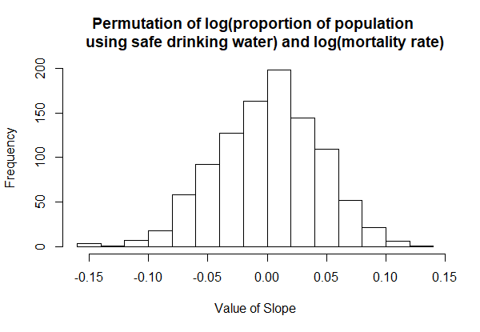
Initial Slope: -0.18446
Mean: 0.00082110
Minimum: -0.15734
Statistically Significant!
Histogram 3:
Proportion of Safe Water and Mortality Rate
Notes:
Work Method: We have chosen to simulate 1000 trials of permuting the first variable (log(proportion of population using safe drinking water)) in order to see if our specific slope value is due to randomness alone. In terms of R code, we have used “for-loops” and “sample” function to shuffle the values of the first variable.
Because our initial slope( with no permutation) was lower than the minimum of the randomized trial values, we came to the conclusion that the slope of our model is statistically significant.
ant.

Slide 36
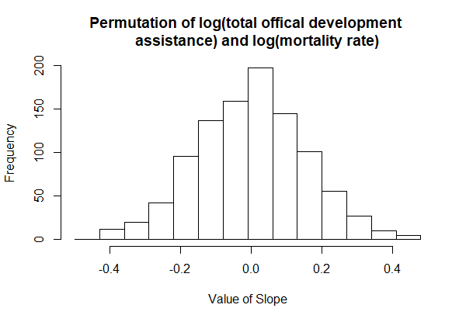
Histogram 4:
Total Official Development Assistance and Mortality Rate
Initial Slope: 0.16631
Mean: 0.00095952
Maximum: 0.47641
~13.9% of trials greater than our slope
NOT Statistically
Significant!
Notes:
Work Method: We have chosen to simulate 1000 trials of permuting the first variable (log(total official development assistance)) in order to see if our specific slope value is due to randomness alone. In terms of R code, we have used “for-loops” and “sample” function to shuffle the values of the first variable.
Because approximately 14% of our random generated slope values were bigger than our initial slope, we came to the conclusion that our slope is not statistically significant.

Slide 37
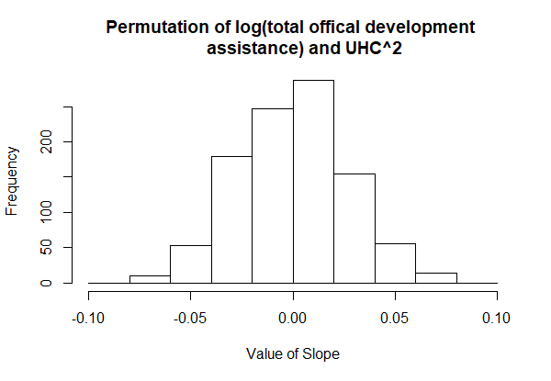
Histogram 5:
Total Official Development Assistance and UHC
Initial Slope: -0.039909
Mean: 0.00030435
Minimum: -0.070657
~6.3% of trials smaller than our slope
NOT Statistically
Significant!
Notes:
Work Method: We have chosen to simulate 1000 trials of permuting the first variable (log(total official development assistance)) in order to see if our specific slope value is due to randomness alone. In terms of R code, we have used “for-loops” and “sample” function to shuffle the values of the first variable.
Because approximately 6.3% of our random-generated slope values were smaller than our initial slope, we came to the conclusion that our slope is not statistically significant.

Slide 38
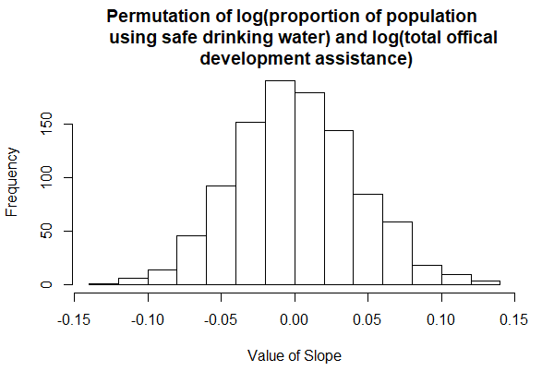
Histogram 6:
Proportion of Safe Water and Total Official Development Assistance
Initial Slope: -1.0593
Mean: 0.0013328
Minimum: -0.13151
Statistically
Significant!
Notes:
Work Method: We have chosen to simulate 1000 trials of permuting the first variable (log(proportion of population using safe drinking water)) in order to see if our specific slope value is due to randomness alone. In terms of R code, we have used “for-loops” and “sample” function to shuffle the values of the first variable.
Because our initial slope( with no permutation) was way lower than the minimum of the randomized trial values, we came to the conclusion that the slope of our model is statistically significant.

Slide 39
New Indicators
07

Slide 40
Goal 3: Good Health and Well-Being
Mental Well-Being (Depression)
Randomly survey a sample of 200 people to determine how many are clinically diagnosed with depression
Multistage sampling: Stratified sampling + Cluster sampling
Stratified: Split into various age groups (children/teenagers, adults & elderly)
Cluster: Select clusters of each age group to survey (schools, CBD, silver zones ie place with more elderly)
Upside: less time consuming & easier logistic wise
Downside: need to assume that the people who are surveyed are representative of their own age group
Make 5 replicates
Upside: easy to manage and can check for difference in results across sample
Downside: insufficient replicates to generate reliable data perhaps
General Difficulties
People might not be willing to share their history of illnesses

Slide 41
Goal 6: Clean Water and Sanitation
Particles in Tap Water (PPM)
Collect tap water from 100 households and check for PPM value
Multistage sampling: Stratified sampling + Cluster sampling
Stratified: Split into urban and rural area
Cluster: Select clusters of households in each area (1 district in urban area and 1 village in rural area)
Upside: less time consuming & easier logistic wise to just pick clusters of households
Downside: need to assume that the water sampled in the specific region (clusters) is representative of their area (rural/urban)
Make 10 replicates
Upside: able to easily conduct once original methodology has been established
Downside: difficult to control certain variables (eg. income disparity between areas of the same kind)
General Difficulties
May not be able to easily isolate causes of PPM disparities (eg. two different rural areas may have different environ factors causing the differences)

Slide 42

THANK YOU!
WEST

